Slide 1
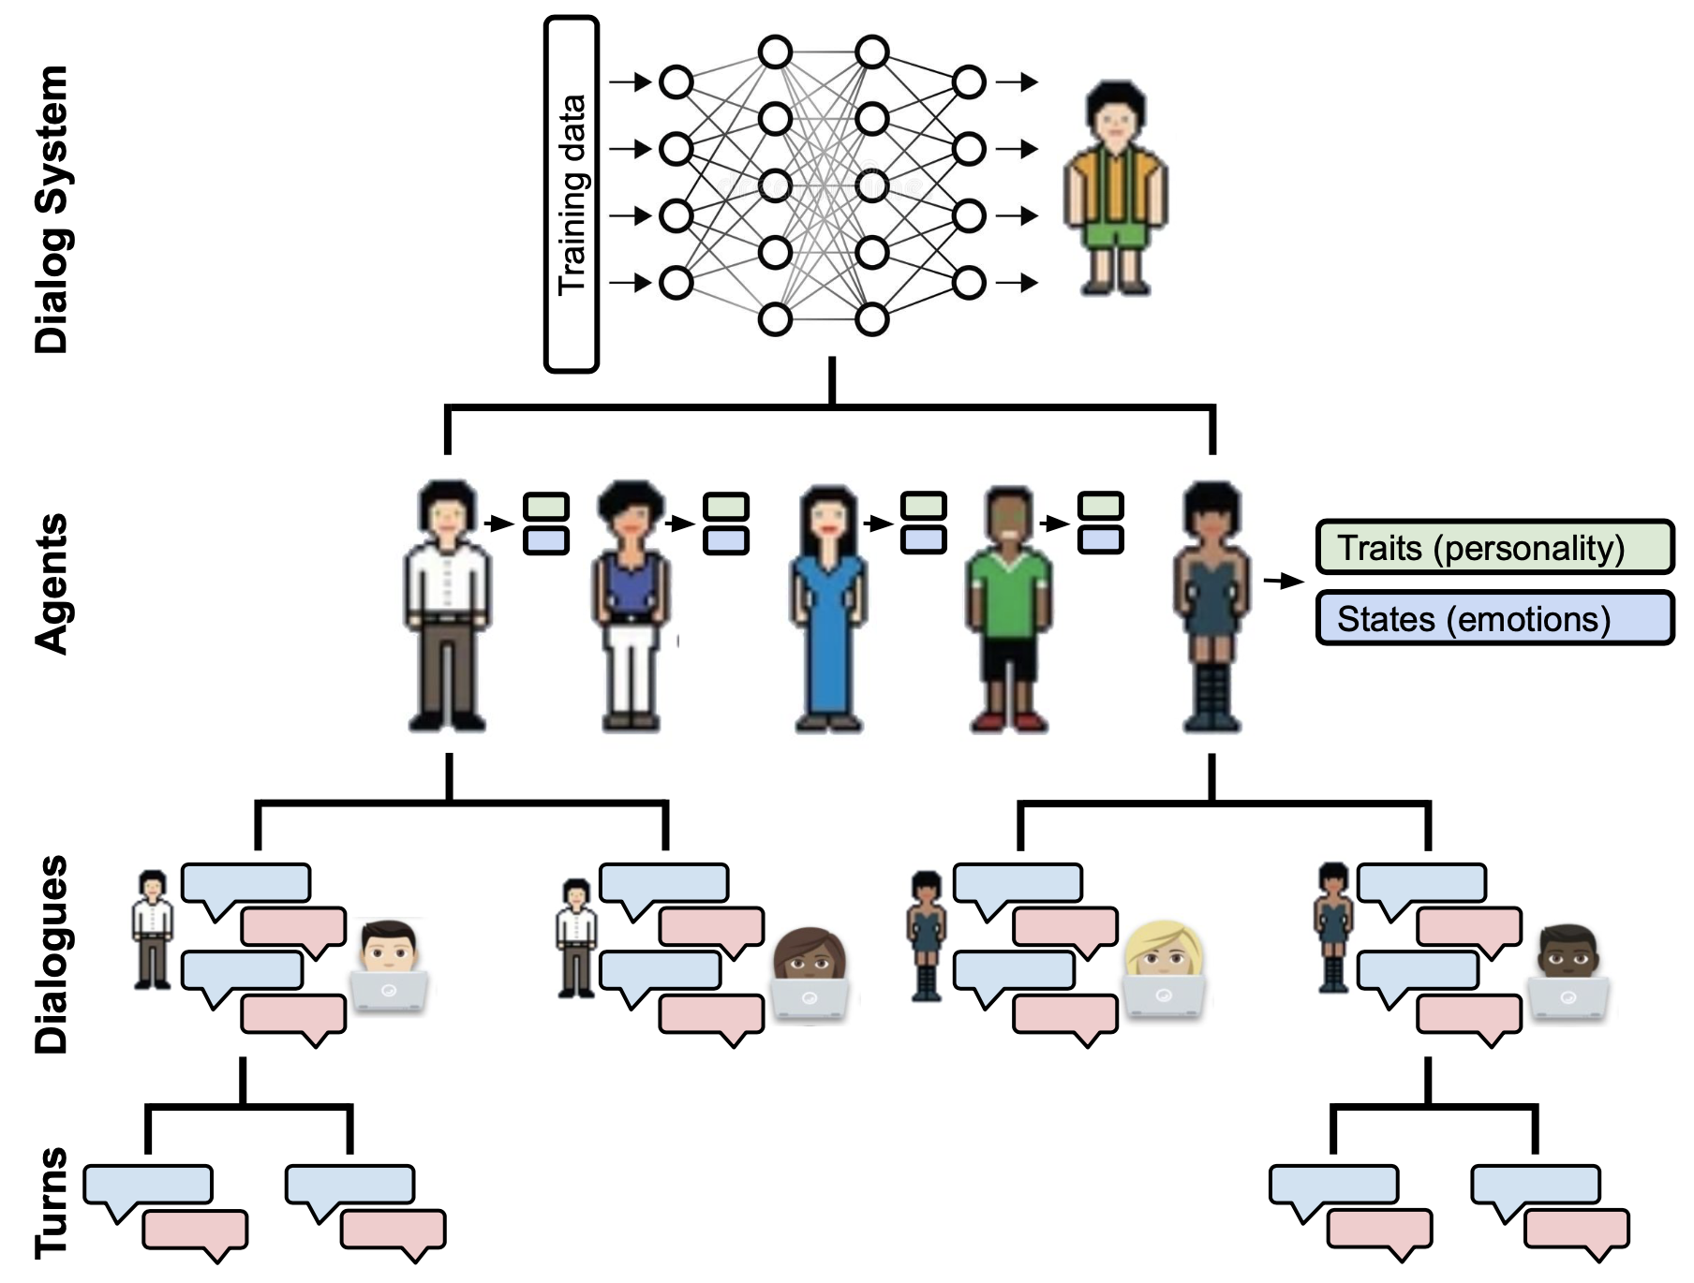
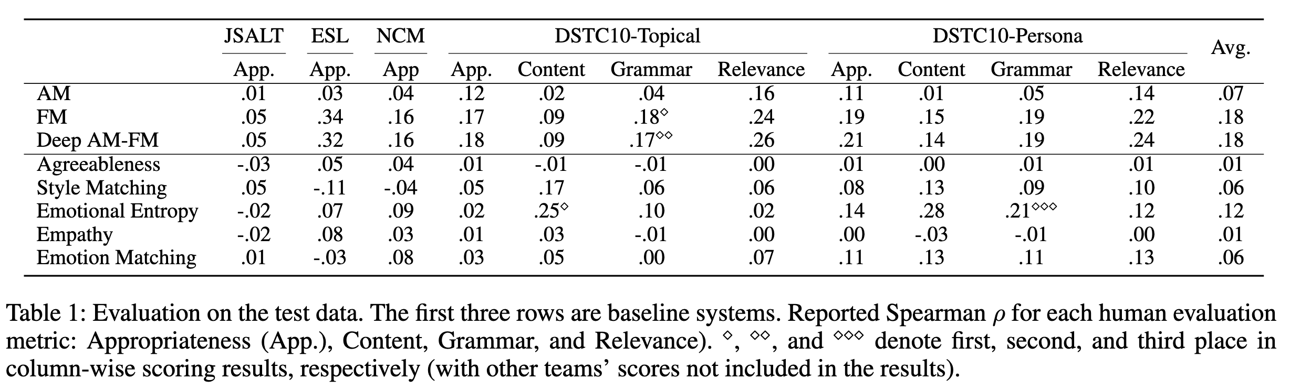
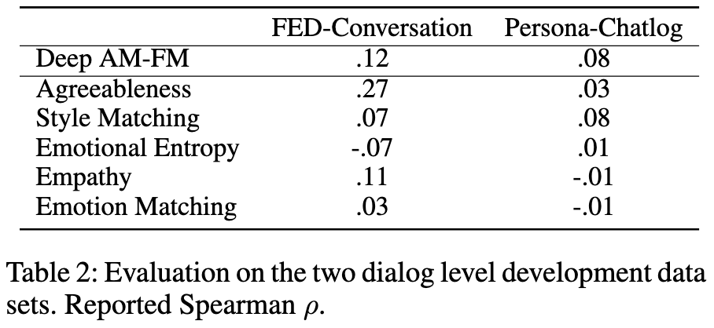
A Human-Centered Hierarchical Framework for Dialogue System Construction and Evaluation
Salvatore Giorgi¹, Farhan Ahmed², Lyle Ungar¹, H. Andrew Schwartz²
¹University of Pennsylvania, ²Stony Brook University
Introduction
The Hierarchy
Human-Centered Measures
Conclusions
Goal: human-like open-domain system
Dialog agents are created with human-like traits
Empathy, personality, emotions
Dialog agents are also evaluated as humans
Which speaker sounds human?
Does this response make sense?
The current work
Define a hierarchical framework for dialog system evaluation
Propose psychologically-grounded and human-centered evaluation measures
We propose two general sets of human-like measures
States and Traits
States: thoughts/behaviors in a specific place/time
Traits: generalize across situations, stable across time
Linguistic Matching
unconscious matching tendencies in postures, facial expressions, pitch, pausing, length, and use of function words
Trait-level measures worked best when evaluated at higher levels (dialogs)
State and matching measures worked best on turn-level data
Limited task data (evaluated at the turn-level only)
Metrics not optimized to correlate with task metrics (grammar, etc.)
Task Metrics
Agreeableness¹ | Trait | Dialog system, agent
Empathy² | Trait | Dialog system, agent
Emotional Entropy³ | State | Agent, dialog, turn
Linguistic Style Matching⁴ | Matching | Agent, dialog, turn
Emotion Matching³ | Matching | Agent, dialog, turn
Dialogue System Technology Challenge 10
Results
Ethics
Task: Create metrics which
Correlate with human judgements
Are explainable
Data: Evaluated across 5 turn-level data sets,
Evaluation: metrics must correlate with human evaluations
Appropriateness
The response is appropriate given the preceding dialogue.
Content
How much information is provided in the response.
Grammar
The quality of the English grammar.
Relevance
The response content is related to the preceding dialogue.
Privacy, toxic and offensive content, willingness to share research
Imparting system with human qualities can be dangerous
Alternatively, dialog systems may exhibit extremely limited variation in such traits
Potential "Wall Street Journal effect”: dialog system only converse like middle aged white men
References
Park, G., Schwartz, H. A., Eichstaedt, J. C., Kern, M. L., Kosinski, M., Stillwell, D. J., ... & Seligman, M. E. (2015). Automatic personality assessment through social media language. Journal of personality and social psychology, 108(6), 934.
Abdul-Mageed, M., Buffone, A., Peng, H., Eichstaedt, J., & Ungar, L. (2017, May). Recognizing pathogenic empathy in social media. In Proceedings of the International AAAI Conference on Web and Social Media (Vol. 11, No. 1, pp. 448-451).
Mohammad, S. M., & Kiritchenko, S. (2015). Using hashtags to capture fine emotion categories from tweets. Computational Intelligence, 31(2), 301-326.
Ireland, M. E., Slatcher, R. B., Eastwick, P. W., Scissors, L. E., Finkel, E. J., & Pennebaker, J. W. (2011). Language style matching predicts relationship initiation and stability. Psychological science, 22(1), 39-44.
Table 1 (turn-level data):
Emotional Entropy (state) performs best on turn-level data
Matching metrics outperform traits
Table 2 (dialog-level data):
Trait level measures outperform others at the dialog level

